Slide 1

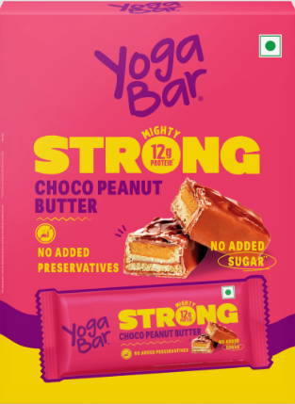
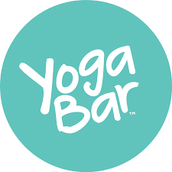
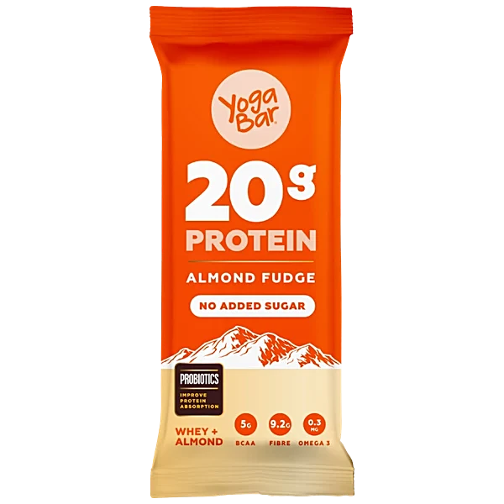


Case Study
The FMCG Food Startup Blueprint
Insights from 'YOGA BAR'
@sriks023

Slide 2
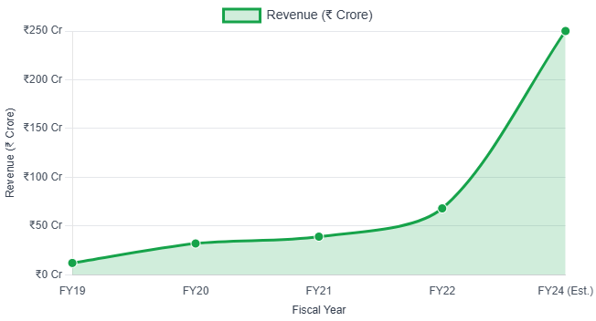
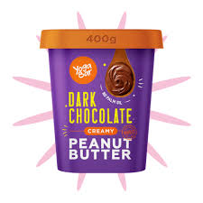
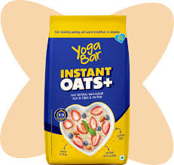
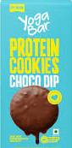
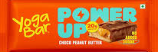
Yoga Bar is an Indian healthy food company founded by sisters Suhasini and Anindita Sampath. Originally operating as Sproutlife Foods, the company is known for its range of healthy, protein-rich products, leading to a strategic acquisition by ITC.
Yoga Bar products always surprise me because of its products, name, packing colors, fonts they using in that & the information founder share in her every podcasts.
In this case study I tried to summaries the key points i learnt from Yoga bar to run successful FMCG food company.
Revenue Growth of Yoga Bar
@sriks023

Slide 3
Identify Opportunity Gaps: The founders identified a market gap in India for healthy, protein-rich food products, which were rare at the time.
Start Lean with Capital: e.g., Yoga Bar started with ₹25 lakhs from investors and 10+lakhs from founders' savings.
Understand D2C Viability for Food: Be aware that Direct-to-Consumer (D2C) models for food products can be challenging. A gross margin of at least 35% is generally crucial for D2C profitability in this sector, as personal care products often have higher margins.
Understand fundamental financial principles like the compound effect of money for long-term growth planning.
Develop the confidence and commitment to assure investors and lenders of your ability to repay and grow the business.
Stay Informed on Government Schemes: Under the Central government scheme called CGTMSE, which offers interest rates between 7% and 8%, Yoga Bar's founders obtained a loan of almost ₹1 crore.
Brand's Core Feeling: “Brands is not about what you sell, it is how consumers feel after consuming it”.
Proper usage of LinkedIn & Cold-Emailing
1. Before Starting the Company
This section is the foundation to consider before you even launch your FMCG food venture.
@sriks023

Slide 4
2. After Starting the Company
Just as much as we nurture a child during its growth phase, so too should a company be nurtured...
Maintain Transparency: Yoga bar founders give every 3 months updates to their angel investors about the company's growth and challenges.
Be Patient with Product Validation: If your product shelf life is 9-months, you need to wait at least 15 months to know your product has truly resonated with the market.
Build Bank Confidence: When seeking loans from banks, present clean documentation and a clear, well-articulated future plan to minimize perceived financial risk and gain their trust.
Example : 1,00,000 people * 12 bars/month = 100cr company
Like above example, founder present their idea in front of loan facilitators
Master Modern Trade: Develop a deep understanding of how "modern trade" retail channels (supermarkets, hypermarkets) operate to effectively place and promote your products.
(ನಿಮ್ಮ product ಅಂಗಡಿಯಿಂದ ಹೊರ ಹಾಕದೇ ಇರೋ ತರ ಮಾಡೋ best trick - ಅಂಗಡಿ ownerಗೇ sample products ಕೊಟ್ಟು "ನಿಮ್ಮ ಮನೆಯಲ್ಲಿರೋ ಮಕ್ಕಳಿಗೆ ಕೊಡಿ" ಎನ್ನುವುದು)
@sriks023

Slide 5
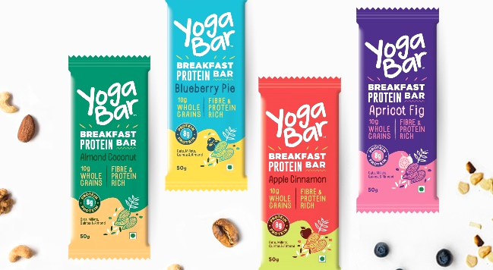
Engage in Grassroots Marketing: In the early days of Yoga bar founders actively participated in direct, on-the-ground marketing, such as visiting 10 yoga studios daily.
Direct Customer Feedback: Instance, founder printed her contact number on packaging to receive direct reviews and build customer relationships. (Until ITC took over)
Authentic Products: “We feed our products to our children” Create products of such high quality and integrity that you would confidently offer them.
Recognize that attractive and informative packaging, alongside strong relationships with store owners, are two main pillars for success in the FMCG sector.
Define Product Positioning: Clearly articulate your product's unique selling proposition and how it stands out from competitors.
Conversion Rates: Reaching a large audience (e.g., 10 lakh people) will only convert a fraction (e.g., 1 lakh) into actual customers.
3. Marketing Tactics
If you create an amazing product but don't make it reach people and companies, it's as if you've killed your own product.
@sriks023

Slide 6
4. To Achieve Success
"
This Section highlights the long-term strategies and metrics essential for sustained growth and market leadership.
Long-Term Partnerships: Maintaining high-volume relationships with key clients (e.g., supplying 50,000 products to Indigo for over 10 years).
Prioritize Repeat Customers: High repeat customer ratio e.g., 69% for Yoga Bar, as this indicates strong product-market fit and loyalty.
Build Extensive Distribution: As of 2024 Yoga bar products available in 4500+ stores around the world.
Demonstrate strong performance in local and smaller stores to earn the opportunity for broader distribution, this will turn as red carpet welcome in D-Mart, Reliance like large retail chains.
Ensure Fast Product Movement: Your products must sell quickly off the shelves to build confidence and strong relationships with retailers.
Monitor Key Sales Metrics: Consistently analyze "same-store sales growth" and "per SKU growth within the same store" to understand product performance and identify areas for improvement.
Plan for Scalable Manufacturing: Invest in automated manufacturing facilities for long-term efficiency and capacity (e.g., Yoga Bar's 60,000 sq ft factory in Tumkur).
@sriks023

